Slide 1



Getting published:
My personal experience
Michael D. Myers
Professor of Information Systems
Department of Information Systems and Operations Management
University of Auckland Business School

Slide 2
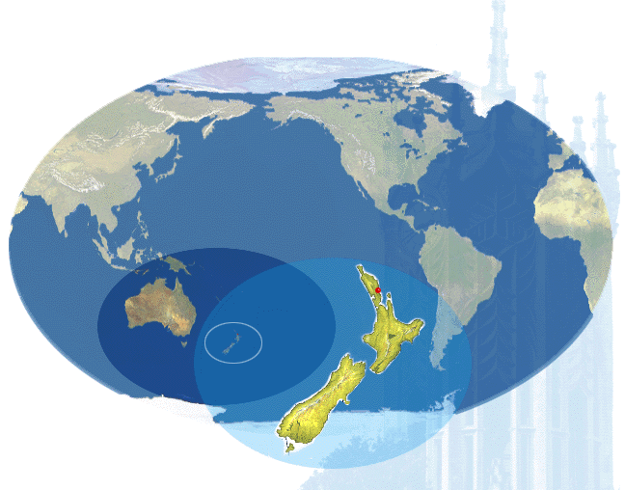
World Map

Slide 3
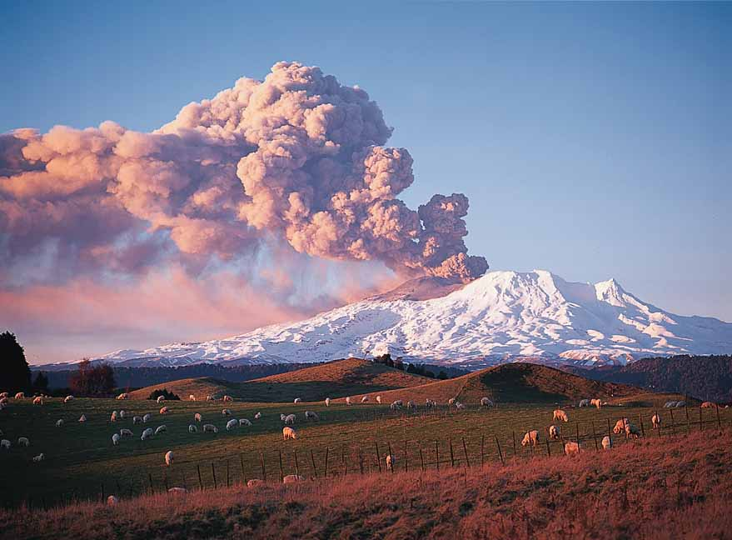

Slide 4


Slide 5


Slide 6


Slide 7


1. A Brief biography
Professional musician (1978-1980)
PhD in Social Anthropology 1984
  Used ethnography to study culture, politics, and change
Worked for IBM New Zealand 1984-1988
Worked at the University of Auckland 1989 – present
  Lecturer in 1989
  Professor of Information Systems since 2000
  Associate Dean 2003-2007; HOD 2009-present
President of AIS (2006-2007)

Slide 8
Editorial and Publishing Experience
Editorial / Reviewing experience includes…
Senior Editor of MISQ, ISR, I&O and PAJAIS
Associate Editor of ISR, ISJ, MISQ
Editorial Boards of I&O, ISJ, ITP, JAIS, CAIS, JoSIT and QROM
EIC of UABR
Reviews for MS, EJIS, JSIS, JMIS etc
Publishing experience includes…
MIS Quarterly
Communications of the ACM
Communications of the AIS
Information and Organization
Information Systems Journal
Information Systems Research
Information Technology & People
Journal of Information Technology
Journal of MIS
Journal of Strategic Information Systems
Journal of Global Information Management . . .

Slide 9
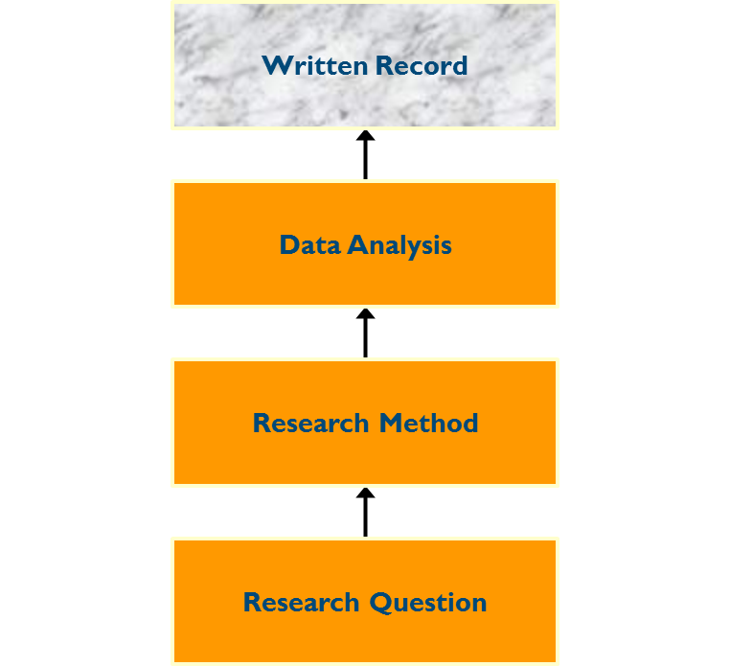
Introduction
A useful motto for every researcher - “Research is not finished until it is published”
Publishing your work allows others to learn from it
A publication can contribute to the body of knowledge in a particular field
Getting published

Slide 10
Publication outlets
Academic peer-reviewed journals
Business magazines
Conference proceedings
Books
Chapters in edited books
Newspaper articles
Web pages
For researchers in most disciplines, articles in academic peer-reviewed journals are the most important
ERA system in Australia
Getting published

Slide 11
The peer-review process
By definition, the peer-review process is a social process. Peer review involves having your work evaluated by others
The review process varies from virtually nil to very tough
One defining feature of top journals is their review system e.g. ISR and MISQ
Getting published

Slide 12
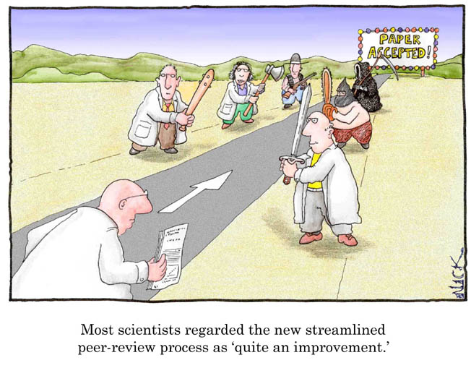


Top Journal
Reviewers
Top Journal
Reviewers

Slide 13

Why are manuscripts rejected?
There are usually two main reasons for rejection:
  The lack of a contribution to knowledge
  The “story” is not convincing
Getting published

Slide 14

The lack of a contribution to knowledge
The paper is unfocused - it is not clear what the main “point” is (often there are many points)
The literature review is inadequate
The manuscript is not sufficiently new or original
The manuscript does not contradict conventional wisdom
Getting published

Slide 15
The story is not convincing or plausible
There is a lack of depth to the story
Evidence comes from a limited range of sources
We are not sure what the researcher did or how they did it
Important data about the organization and the people etc are missing (important for a case study)
There is no “thick description” (important for an ethnographic paper)
Getting published

Slide 16
Possible solutions (1)
Complete the sentence: “the purpose of this paper is”
Have a paper in mind right from the start
Ensure that the literature review is complete and current
Ask to be a reviewer for journals and conferences
Attend academic conferences where excellent qualitative research is presented
Ask other researchers what they are working on
Getting published

Slide 17
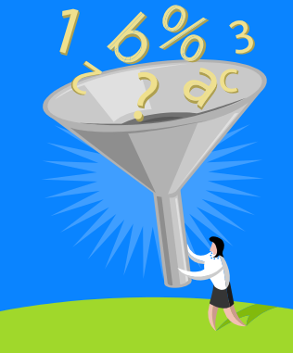
Possible solutions (2)
Ensure a significant mass of data is collected
Include verbatim comments from interviews
Make sure you clearly describe your research method
Specify how your research should be evaluated
Getting published

Slide 18

Practical suggestions
Tell just part of the story in one article
Constantly seek to improve it before submission
Ask another colleague to be a co-author
Agree on a publishing plan
Send your paper to a conference first to get feedback
Send you paper to an appropriate journal
If possible, nominate appropriate editors and reviewers
If the manuscript ends up being rejected, refine, revise, and resubmit elsewhere
Getting published

Slide 19
A Personal Example
Klein and Myers (1999) article entitled “A Set of Principles for Conducting and Evaluating Interpretive Field Studies in Information Systems”
  Won Best Paper Award at MIS Quarterly
  The third most cited paper ever in MISQ
Notes:
I’ll give you two examples.
Vanuatu - Melanesia - south east of Solomon Islands, west of Fiji.

Slide 20
The Journey
Research and Study leave Claremont Graduate University, California 1992
ICIS in Dallas in1992
Heinz Klein visited Auckland 1994
ACIS Paper:
  MYERS, M.D. 'Quality in Qualitative Research in Information Systems.' Proceedings of 5th Australasian Conference on Information Systems, Melbourne, Australia, 1994, 763-766.
Worked on first draft in Semester 2, 1994
Notes:
I’ll give you two examples.
Vanuatu - Melanesia - south east of Solomon Islands, west of Fiji.

Slide 21
Draft (Version 0) – June 1995
From: Allen.Lee
Sent: Thursday, 22 June 1995 13:46
To: Michael D. Myers; Heinz K. Klein
... Both the member of the AE board whom I asked to manage your manuscript through the review process and I have each given the manuscript an initial review to determine its readiness and suitability to be sent out to referees (this is a standard MISQ policy). This person's reaction is that he or she finds the manuscript disjointed, textbookish, far too long, and hence not ready to undergo a review process.
I agree with the potential AE. Based on the numerous and wide variety of manuscripts I have seen as an editor for MISQ over the past five years, my judgment is that your manuscript is unlikely to receive at least a 'revise and resubmit' decision in the first round of the review process. I also believe that your manuscript nonetheless has great potential and can become a major research contribution. Therefore I am asking you to make some major changes in the manuscript ...

Slide 22
Version 1 submitted - May 1996
Visited Heinz a few times in Binghamton, NY
Cut first 39 pages!
Submitted first version May 1996 to MISQ. My letter to Allen Lee:
“Compared to the earlier version that you both looked at, the paper is shorter and much more focused. Its explicit purpose is to suggest principles for the evaluation of interpretive research in IS. These principles are illustrated by evaluating three published examples of interpretive research in IS, all three of which we regard as exemplars.
Notes:
I’ll give you two examples.
Vanuatu - Melanesia - south east of Solomon Islands, west of Fiji.

Slide 23
Version 1 review packet - March 1997
From: Allen.Lee
... None of the three reviews calls for a rejection. Two ask for major revisions and one gives your manuscript an acceptance. My decision is to ask you for a major revision...
Overall, I like your manuscript a great deal. Its scope is impressive. Its goal of proposing evaluation criteria or principles for interpretive field work in information systems is both ambitious and needed.
... Need a better discussion of the proposed principles
... The discussion of the examples is superficial ... (8 pages of reviews)
Visited Heinz again in Binghamton, NY
Submitted second version July 1997 to MISQ

Slide 24
Version 2 review packet - December1997
From: Allen.Lee
... My decision is to ask you for another revision. Yes, there is substantial progress and your manuscript is getting closer to publication. I want to congratulate you on your extensive investment of scholarly effort in a risky research project, where your investment is showing signs of paying off.
... The "neo-positivism" issue is simply not going away, despite all of your valiant efforts (based, in part, on my suggestions) to deal with it.
... Principle 7 is not the same as the others. It is really a meta-principle.
(17 pages of reviews)
Revisions mostly done via email
Submitted third version March 1998 to MISQ

Slide 25
Version 3 review packet – June 1998
From: Allen.Lee
... Congratulations. I am conditionally accepting your manuscript for publication in MIS Quarterly. It is a great, scholarly piece of research. I know you have labored a great deal over it, but I believe that all the work requested of you, and which you have delivered, has addressed serious concerns, with the significant result that you will soon have an excellent (and, likely, a classic) publication.
Please note that the acceptance is conditional, and not guaranteed.
(12 pages of reviews)
Revisions mostly done via email
Submitted fourth and final version September1998 to MISQ
Published March 1999

Slide 26
Conclusion
Publish your work in the best outlets possible
Get involved in the scholarly (social) system
Collaborate
Persevere
Contribute

Slide 27

Questions

